Slide 1





Kokiri Random Forest-Based Cohort Comparison and Characterization
Klaus Eckelt, Patrick Adelberger, Markus Bauer, Thomas Zichner, Marc Streit
klaus.eckelt@jku.at
@klaus_lml
https://jku-vds-lab.at/kokiri

Slide 2
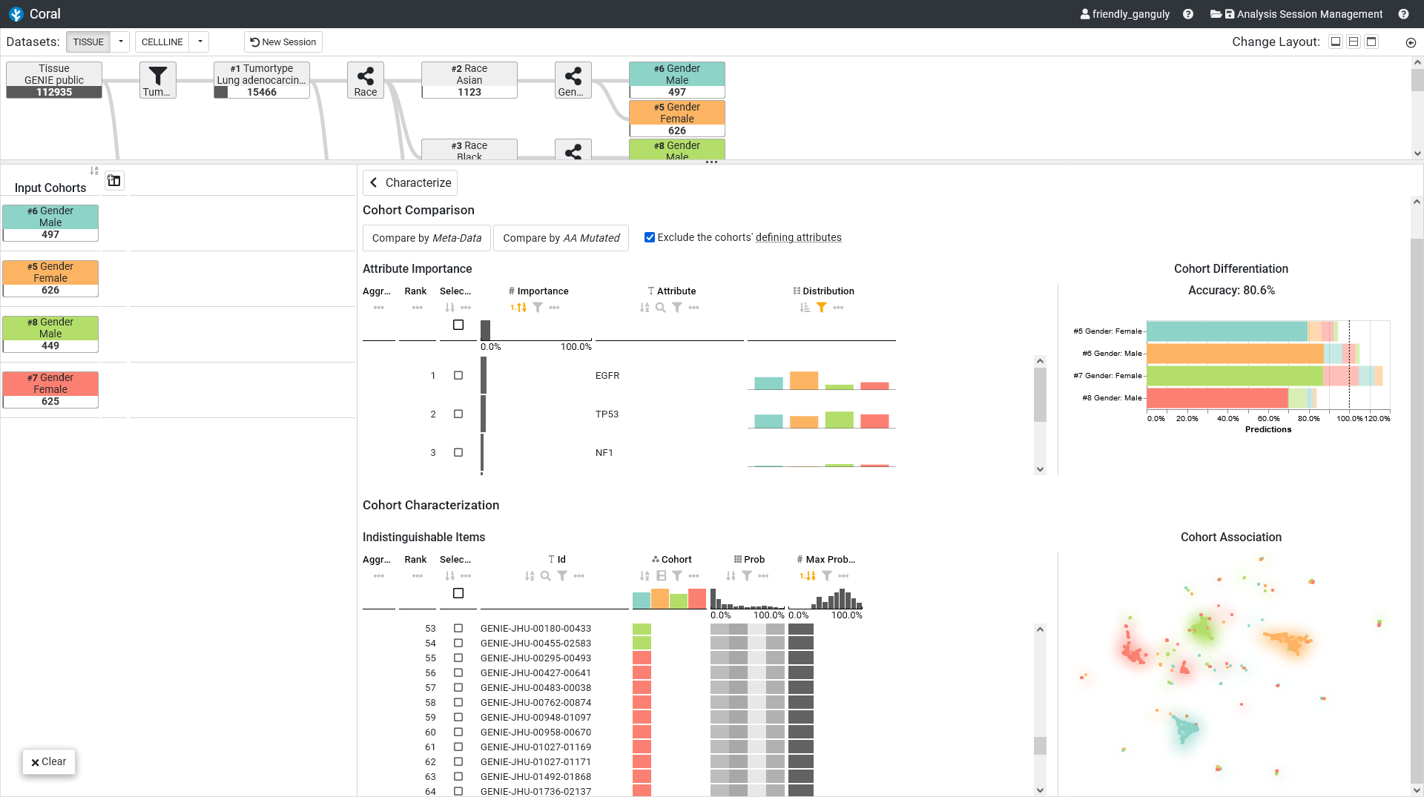
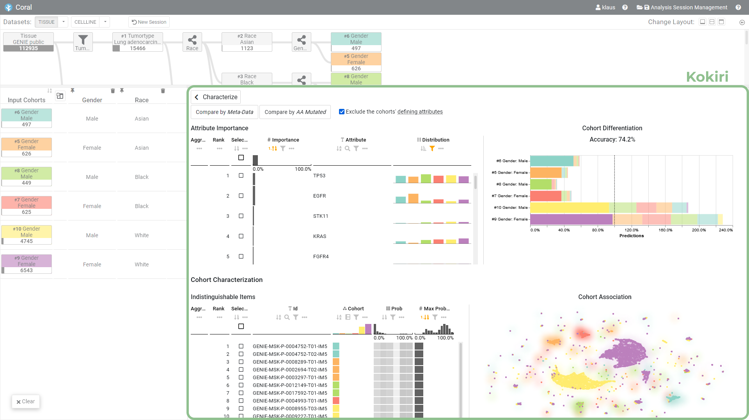
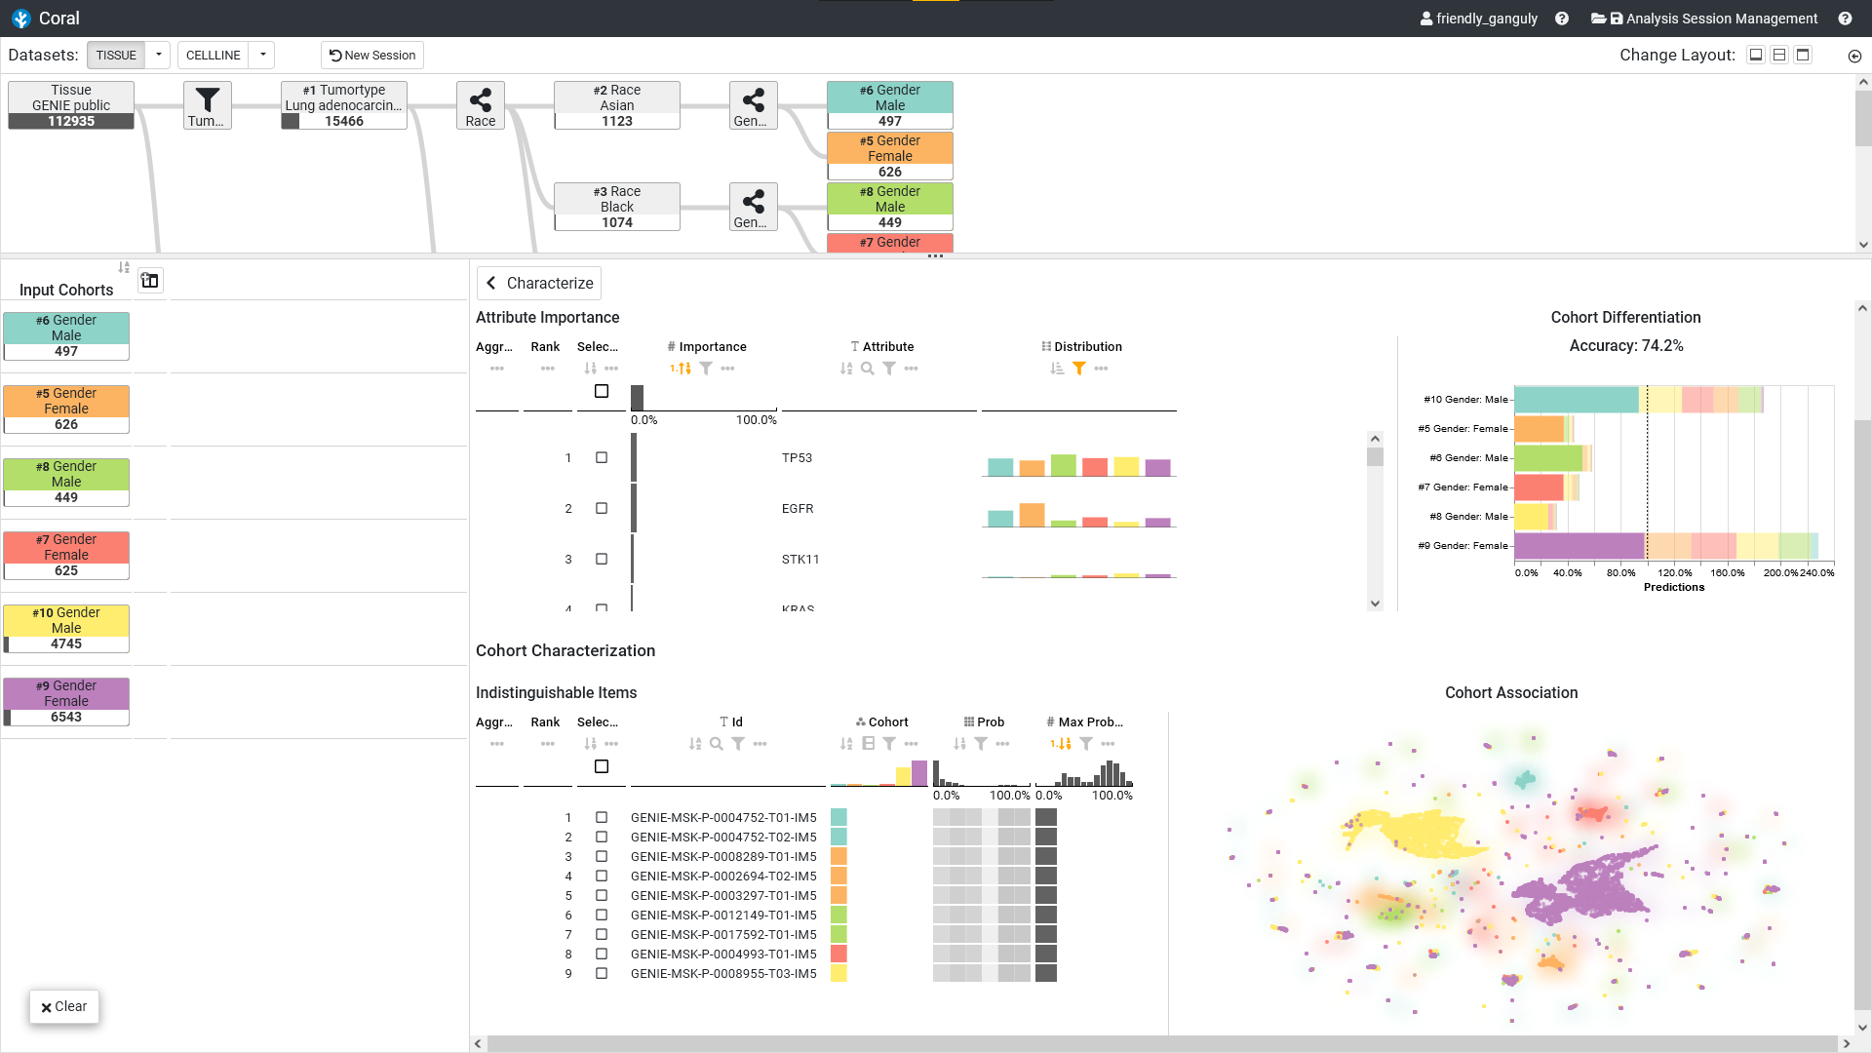

Slide 3
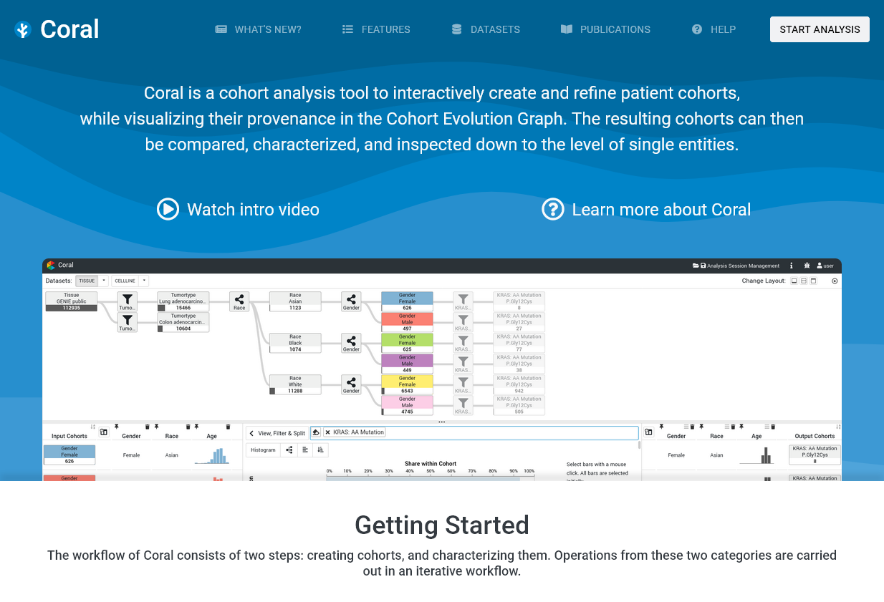
Motivation
😐
😐
😐
☹
🙁
🙁
😐
😐
😐
☹
🙁
🙁
😐
😐
😐
☹
🙁
🙁
P. Adelberger et al., "Coral: a web-based visual analysis tool for creating and characterizing cohorts.“ in Bioinformatics 37.23, 2021

Slide 4
Motivation
😐
😐
😐
☹
🙁
🙁
😐
😐
😐
☹
🙁
🙁
😐
😐
😐
☹
🙁
🙁
P. Adelberger et al., "Coral: a web-based visual analysis tool for creating and characterizing cohorts.“ in Bioinformatics 37.23, 2021

Slide 5
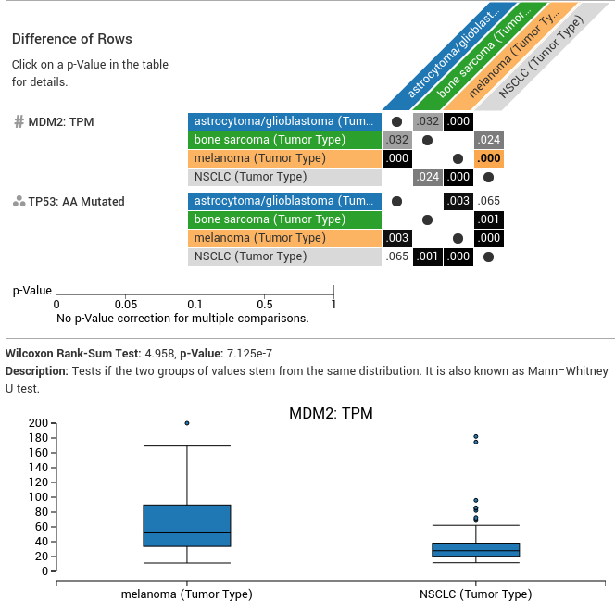
Motivation
K. Eckelt et al., "TourDino: A Support View for Confirming Patterns in Tabular Data.“ EuroVis Workshop on Visual Analytics, 2019
P. Adelberger et al., "Coral: a web-based visual analysis tool for creating and characterizing cohorts.“ in Bioinformatics 37.23, 2021

Slide 6
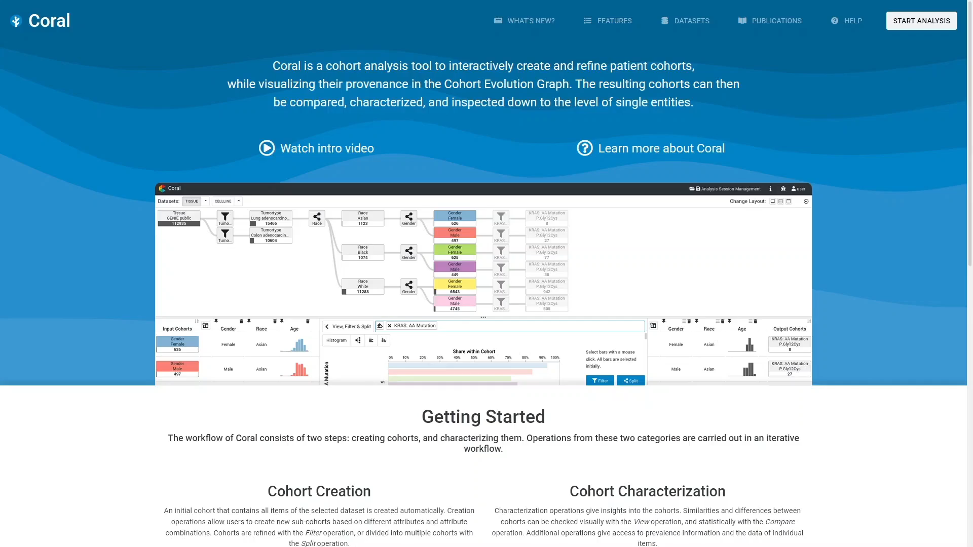
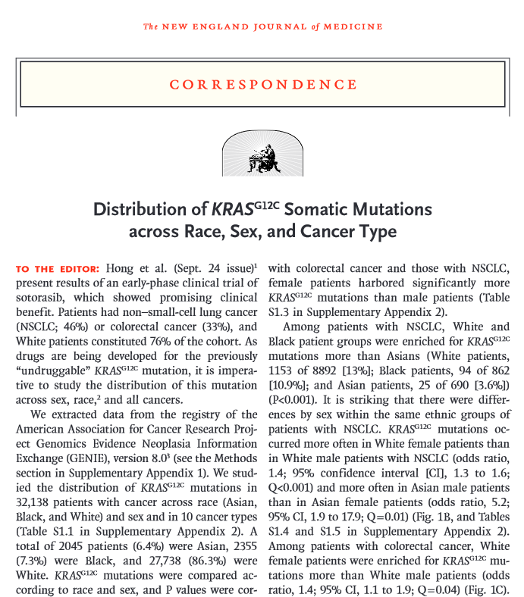
Use Case / Genie Introduction
A.H. Nassar et al., "Distribution of KRAS G12C somatic mutations across race, sex, and cancer type." in New England Journal of Medicine 384.2, 2021

Slide 7
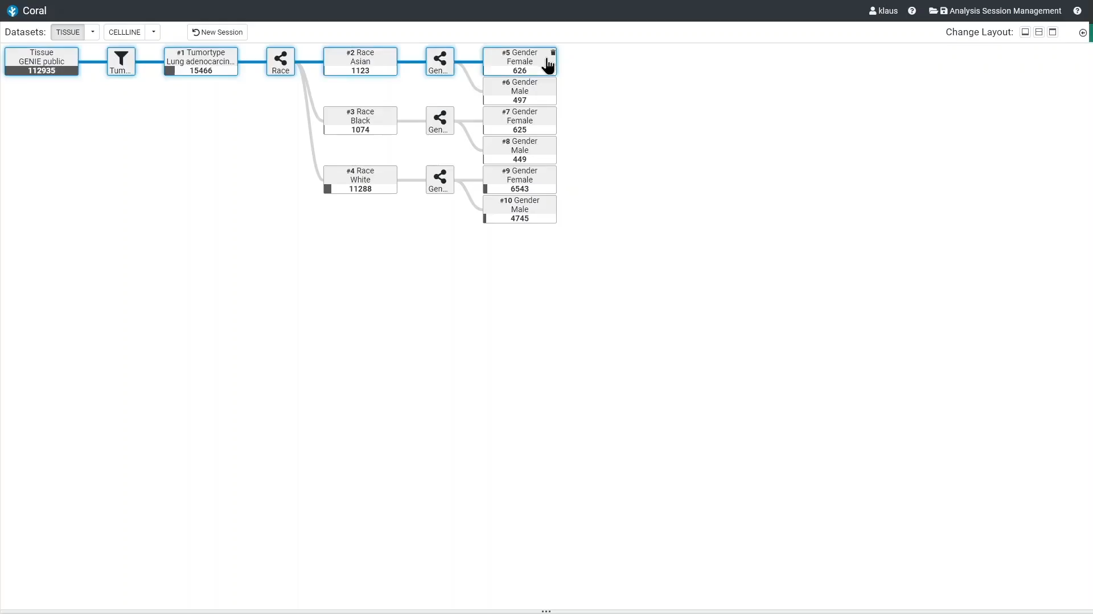
Kokiri Intro, Comparison, Attribute Importance

Slide 8
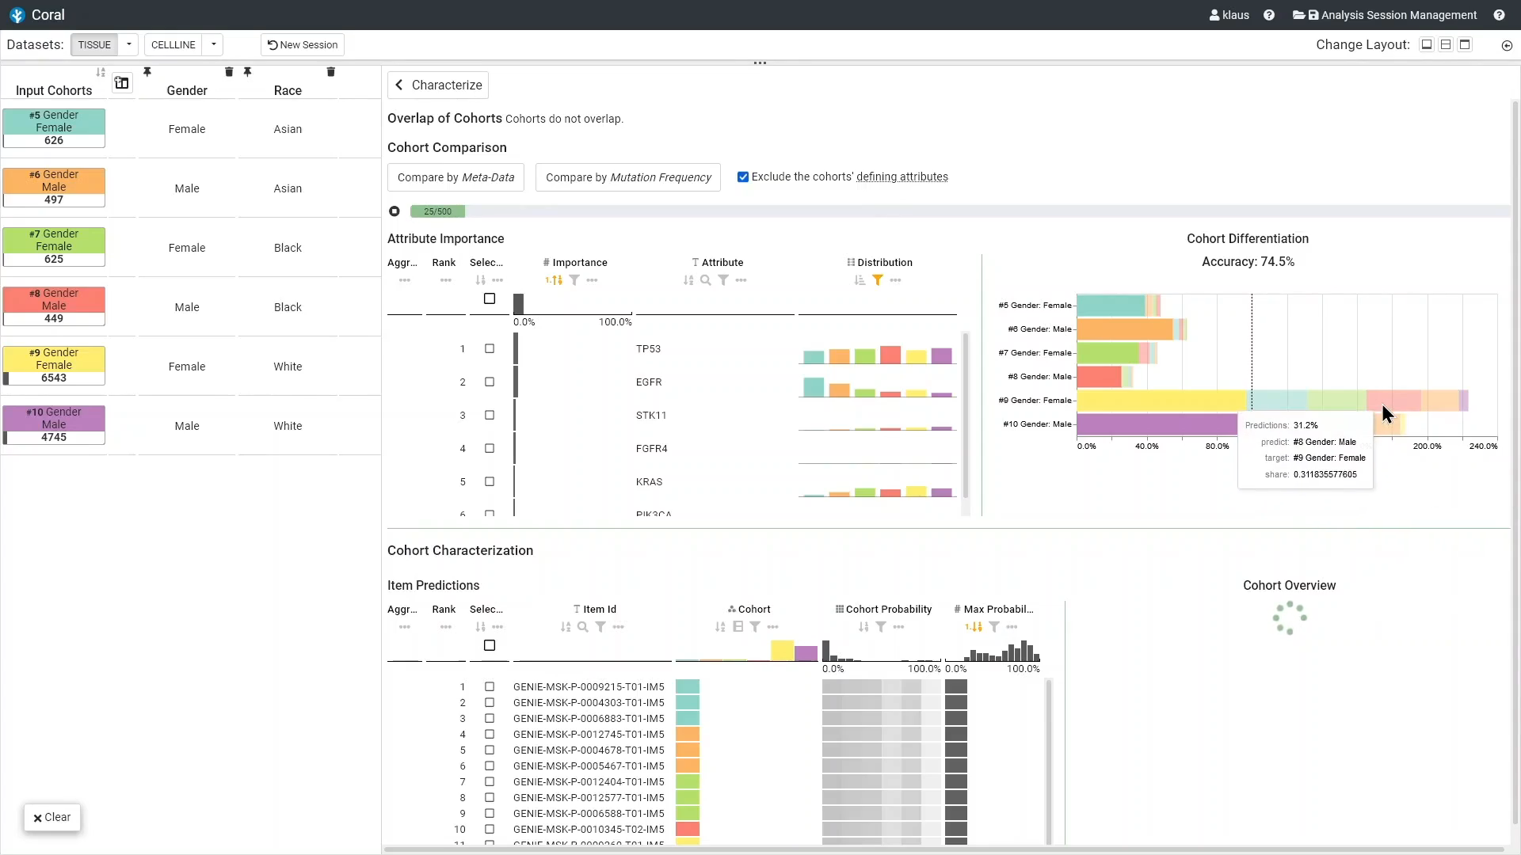
Kokiri Intro, Comparison, Attribute Importance

Slide 9
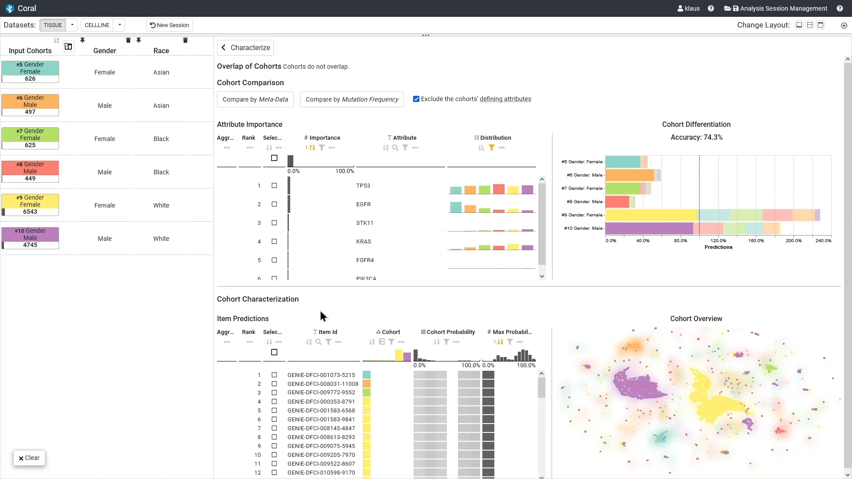

Slide 10
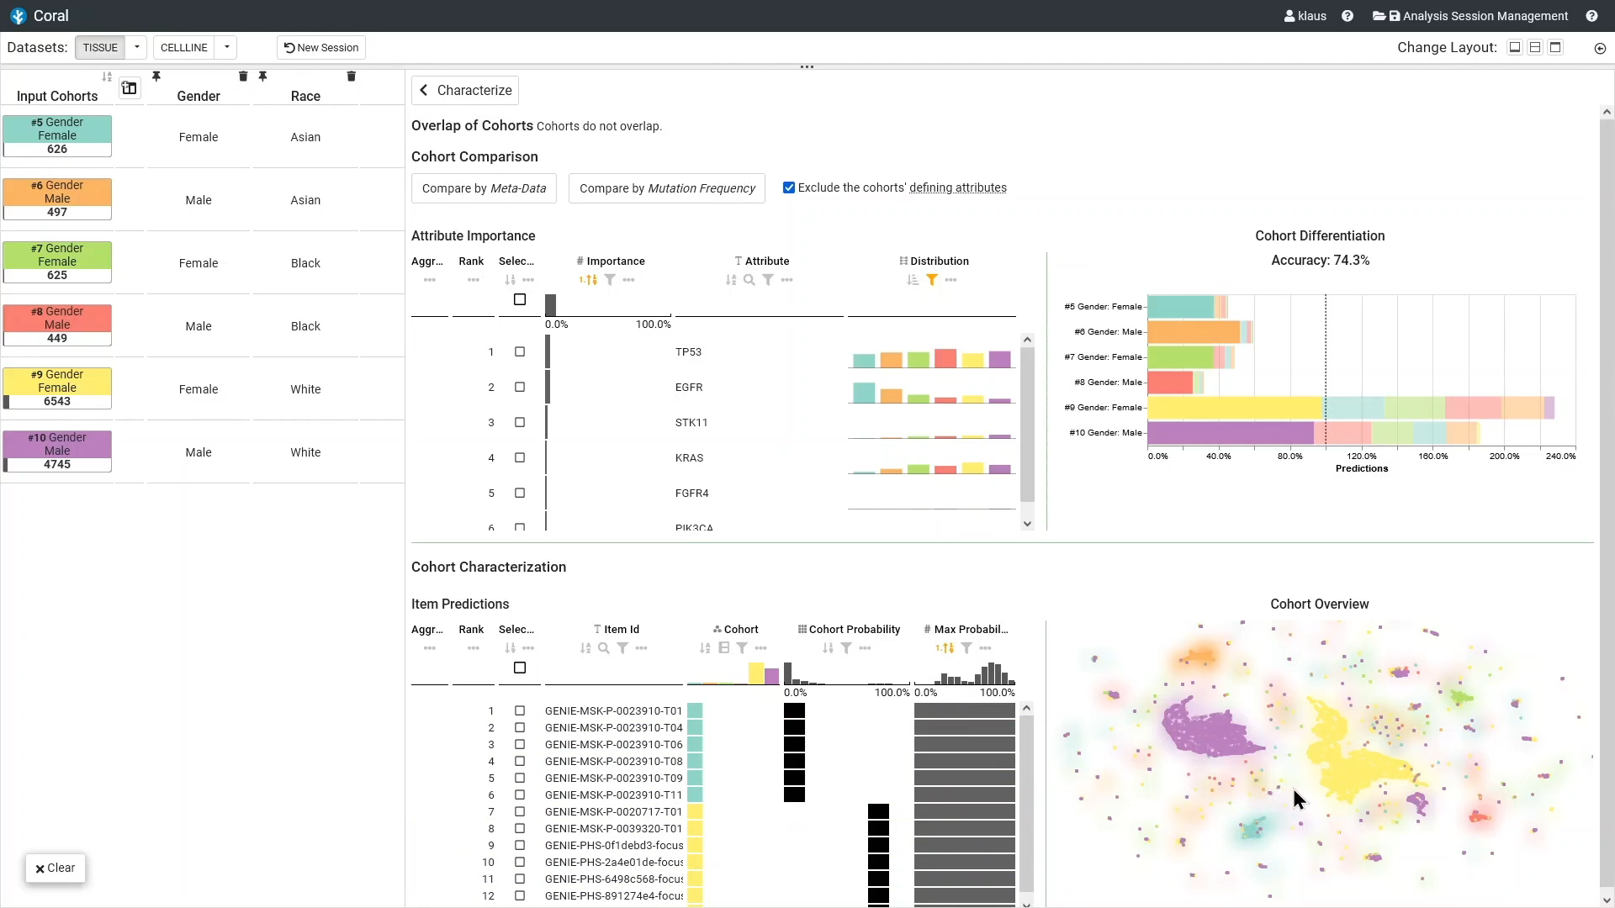

Slide 11
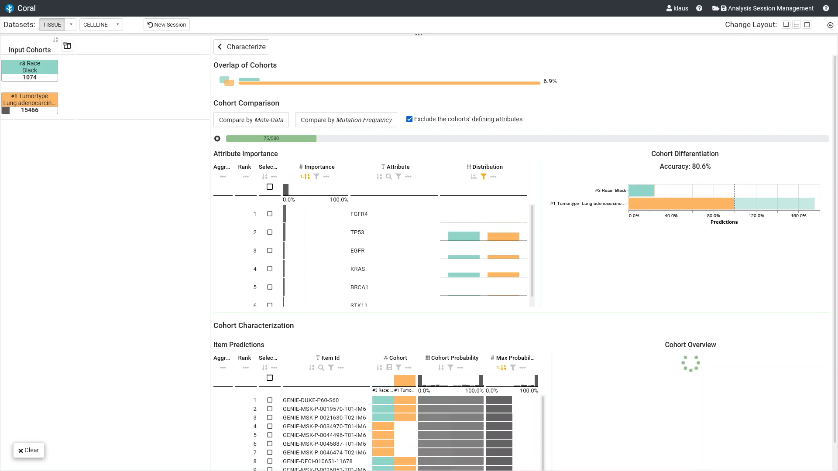

Slide 12
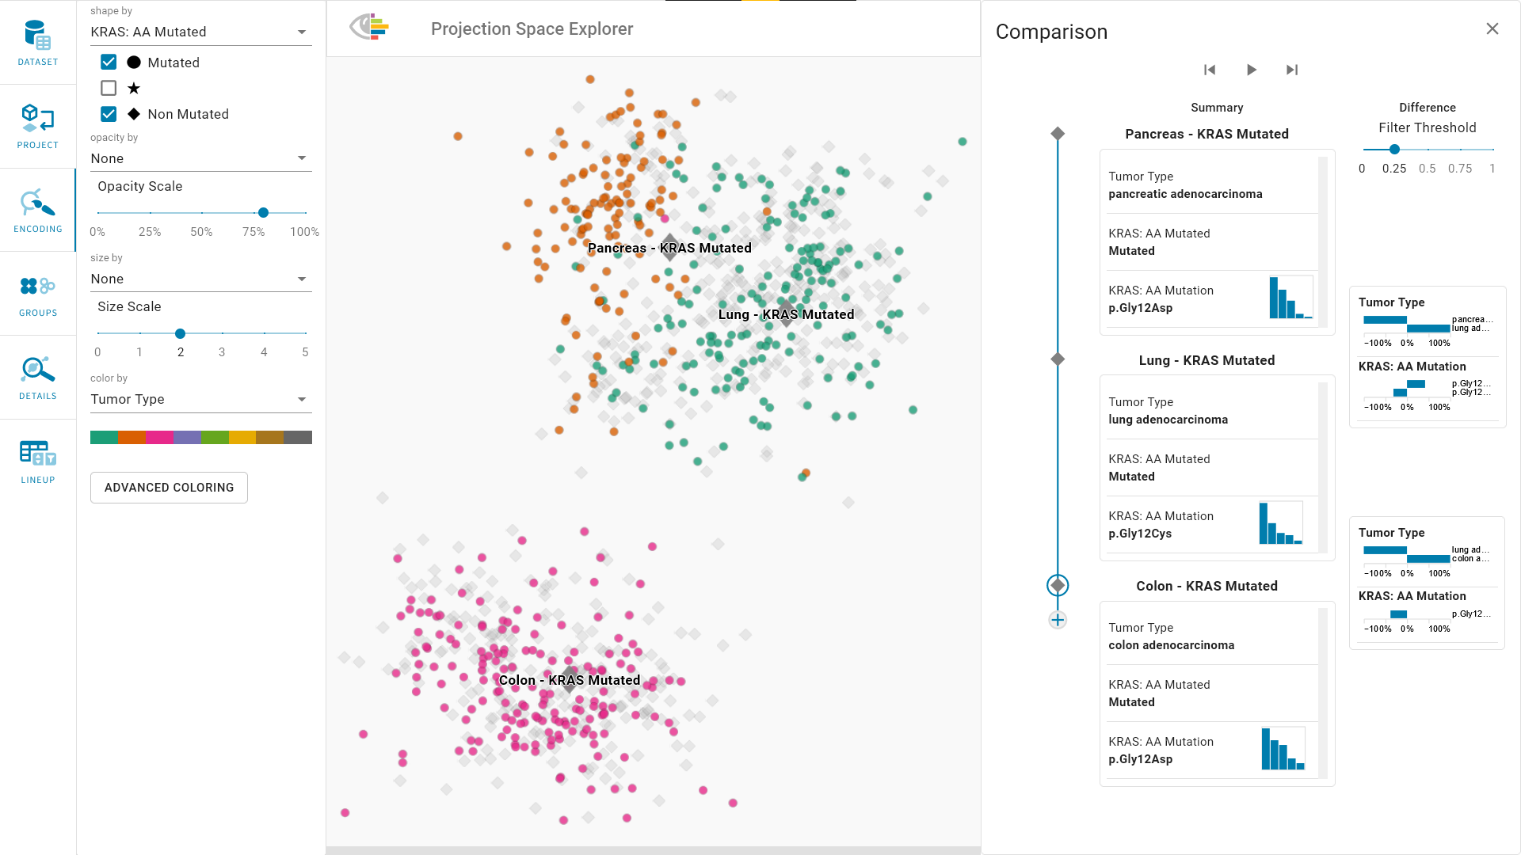
Ongoing & Future Work
Friday, Oct 21st
09:00 AM
Oklahoma Station 1
K. Eckelt et al., "Visual Exploration of Relationships and Structure in Low-Dimensional Embeddings,“ in IEEE Transactions on Visualization and Computer Graphics, 2022, doi: 10.1109/TVCG.2022.3156760.

Slide 13

Kokiri Random Forest-Based Cohort Comparison and Characterization
Klaus Eckelt
klaus.eckelt@jku.at
@klaus_lml
https://jku-vds-lab.at/kokiri

